Slide 1



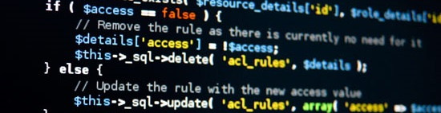
PHP Fundamentals
Course Introduction
SoftUni Team
Technical Trainers
Software University
http://softuni.bg

Slide 2


Table of Contents
Course Objectives
Course Program
Trainers Team
Examination
Learning Resources

Slide 3
Questions
sli.do #PHPFUND

Slide 4

PHP Fundamentals
Course Objectives & Program

Slide 5
PHP Fundamentals – Course Program
Course Introduction – Course Program, Exams, Trainers, Evaluation… XAMPP, PHP IDEs – PHP, CGI, Web server, Running PHP Scripts
PHP Syntax – Syntax, data types, variables, operators, expressions…
PHP Flow Control – Conditionals, loops, exit, return, require, try…catch, declare
Arrays and Strings – Arrays, associative arrays, strings, objects
Functions – Variadic functions, type hinting, anonymous functions
OOP – Creating and using classes and objects, abstraction, polymorphism inheritance, encapsulation

Slide 6


PHP Fundamentals – Course Program (2)
Working with Forms – GET, POST, HTML escaping, query strings, checkboxes, hidden fields, other input types, URL redirecting, sessions
Working with MySQL – Using MySQL database and working in PHP
PHP & MySQL – Practical workshop on creating end-to-end Web applications with PHP and MySQL
CRUD Application
Exam Preparation
Practical Exam

Slide 7


Warning: Not for Absolute Beginners
The “PHP Fundamentals" course is NOT for absolute beginners
Take the “Programing Basics" course at SoftUni first: https://softuni.bg/trainings/courses
The course is for beginners, but requires previous coding skills
Requirements
Coding skills – entry level
Computer English – entry level
Logical thinking
coding skills
required!

Slide 8

The Trainers Team

Slide 9
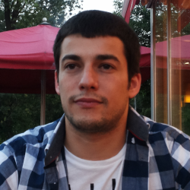
Trainers Team
Stiliyan Ivanov
Web Developer and Technical Trainer
Solid programming experience with
PHP and JavaScript
3 years of experience as a trainer
Programming since high school

Slide 10
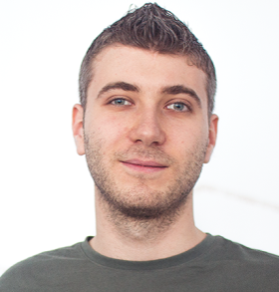
Trainers Team
Ivan Yonkov
Training Lead & Trainer @ SoftUni
5 years of programming experience mainly with Java and PHP
Solid experience as QA engineer
Top performing student from the Software University (2014)

Slide 11

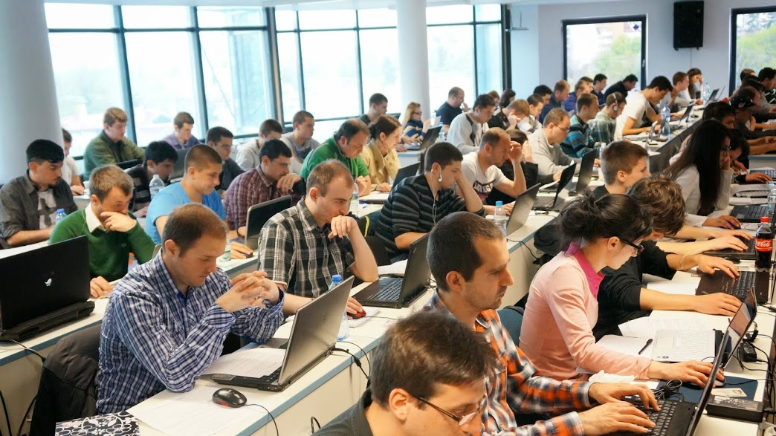
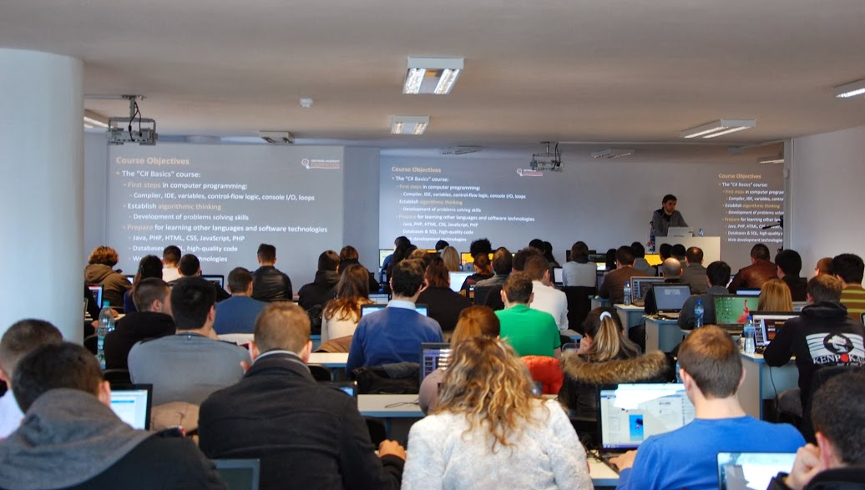
Volunteer Teaching Assistants
Volunteer teaching assistants
Developers from the software industry
Scholarship students from SoftUni

Slide 12

PHP Fundamentals: More Details
Duration, Languages, Technologies

Slide 13


Training Structure – PHP Fundamentals
Lectures
Practical exercises (in class)
Homework (after every lecture or at home)
Team project
Exam preparation
Exam: 6 hours
Schedule: January 2017
Teamwork defense dates: March 2017
Exam date: 19 March 2017

Slide 14
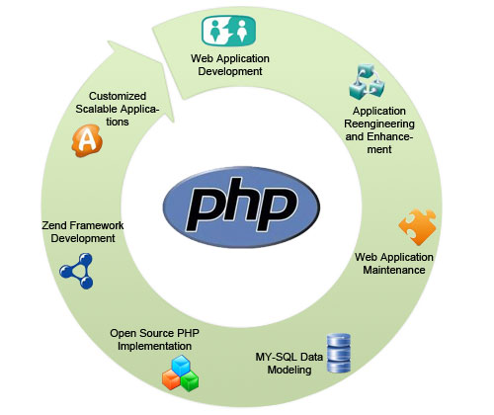
Why PHP?
Understand how the Web really works
You have thousands of PHP applications to choose from
Facebook, Twitter, Wikipedia, WordPress, Drupal, Joomla…
You can use PHP to extend existing applications
PHP is the most widely used server-side programming language.
PHP is open source (freely available for use)
PHP is platform independent
Supports all major web servers

Slide 15



Why English?
Why the slides are in English?
English is the native language of the software engineers
Specific terminology should be in English
Translations are inaccurate and funny
Just learn English!
No excuses

Slide 16
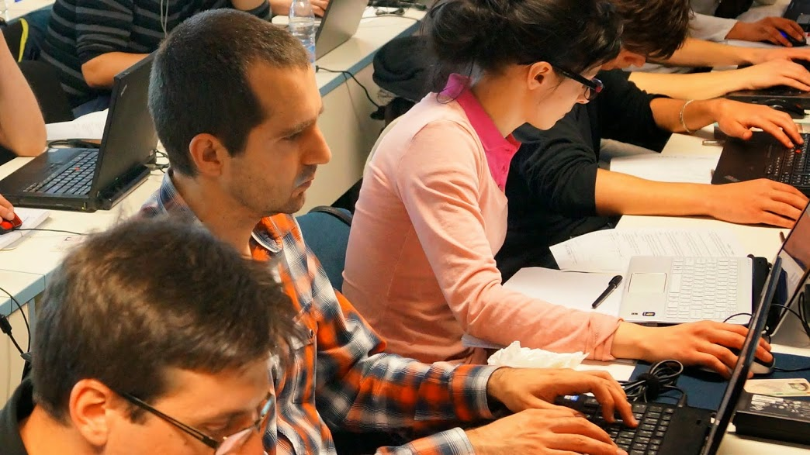


PHP Fundamentals
Evaluation Criteria

Slide 17


Scoring System for the "PHP Fundamentals"
Exam – 70%
Homework – 20%
Teamwork: 10%
No Teamwork: -10%
This applies if accepted and not delivered
Bonuses: up to 10%
Presence in class (onsite students only)
Forum bonuses

Slide 18
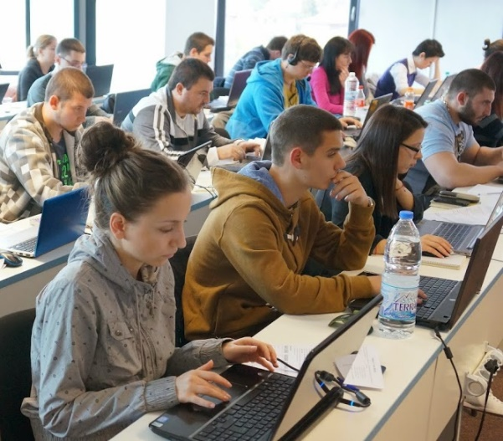

PHP Fundamentals Exam
4 practical problems for 6 hours
Loops – Input forms
Strings – Input forms, HTML output
Associative arrays – JSON input, JSON output
CRUD app – Input forms, validation, OOP, MySQL
You should code in PHP
Automated judge system with real-time feedback
http://judge.softuni.bg
OOP Solutions are evaluated for correctness and style

Slide 19


Homework Assignments
Your homework is mainly work in class!
Lesson days → live workshop
Exercise days → only exercises
How to submit your homework?
Some submitted in the judge system
Others uploaded in the course Web site
Homework assignments are due in 1 week

Slide 20

Teamwork / Practical Project
Build a team
4-6 people
Automatically formed by the system
Develop a practical project
Choose from existing projects
Or work on your own idea
Public defense → demonstrate your work live at SoftUni

Slide 21









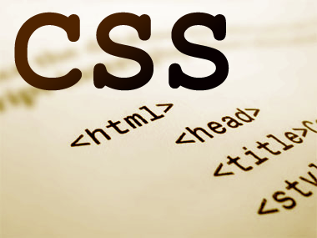
Resources
What We Need Additionally?

Slide 22

Course Web Site & Forums
The PHP Basics official web site:
Register for the "Software University Forum":
Discuss the course exercises with your colleagues
Find solutions for all course exercises
Share source code / discuss ideas / help each other
https://softuni.bg/trainings/1555/php-fundamentals-january-2017
https://softuni.bg/forum

Slide 23



PHP Fundamentals Slides and Videos
All lecture slides, videos, homework assignments, projects and other resources are open content, available for free
Visit the course web site to access the course resources

Slide 24


PHP Resources
PHP Official Site and Documentation
http://php.net
PHP Books
Learning PHP
PHP and MySQL Web Development

Slide 25








PHP Basics – Course Intro
https://softuni.bg/courses/php-basics/

Slide 26
License
This course (slides, examples, demos, videos, homework, etc.) is licensed under the "Creative Commons Attribution-NonCommercial-ShareAlike 4.0 International" license
Attribution: this work may contain portions from
“PHP/MySQL" course by SoftUni under CC-BY-NC-SA license

Slide 27





Free Trainings @ Software University
Software University Foundation – softuni.org
Software University – High-Quality Education, Profession and Job for Software Developers
softuni.bg
Software University @ Facebook
facebook.com/SoftwareUniversity
Software University @ YouTube
youtube.com/SoftwareUniversity
Software University Forums – forum.softuni.bg

